Slide 1
Cognitive Neuroscience Final Exam Review

Slide 2
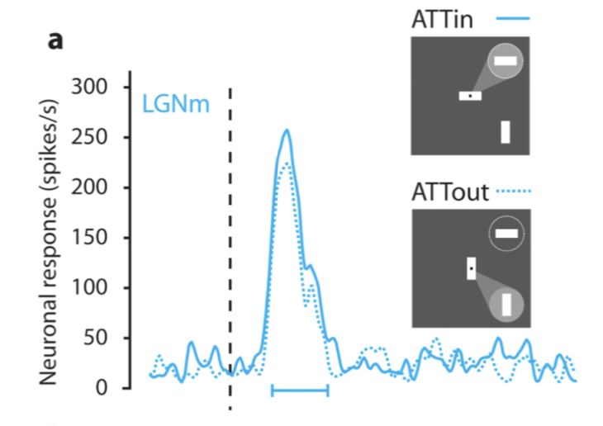
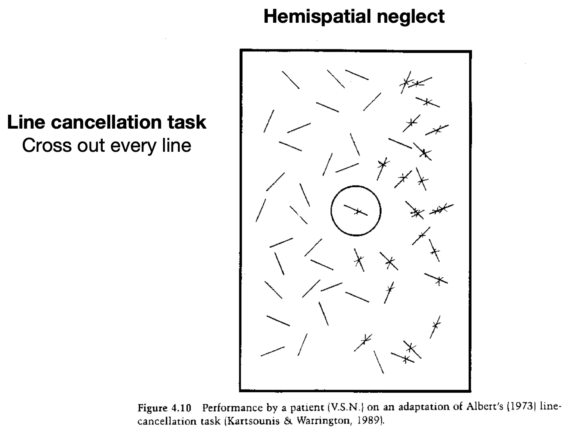
Attention
Vigilance/Sustained Attention
Requires both cholinergic and noradrenergic systems
More effort needed to sustain attention requires more acetylcholine
The noradrenergic system prepares the brain to receive information
Thalamus
Uses glutamate to maintain alertness in the cortex
Eye movements as a measure of overt attention
Saccades vs smooth pursuit
Covert attention (information we receive that we are not focused on)
Think about Helmholtz’ study
Hemineglect
Side of space contralateral to damage is ignored
Late vs. early attention
Where in the visual/conscious pathway does attention start to affect processing areas?
At least as early as the LGN!
Prefrontal cortex (PFC) modulates LGN activity
Source vs. site of attentional control
Sources (areas that modify the processing of other areas): frontal regions including PFC and frontal eye field (FEF)/supplementary eye field (SEF)
Sites (areas that process input): V4 cortex, A1 auditory cortex

Slide 3
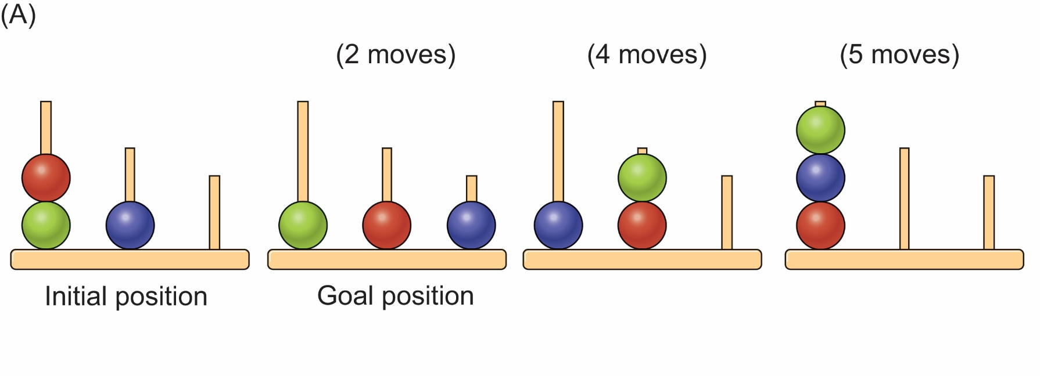
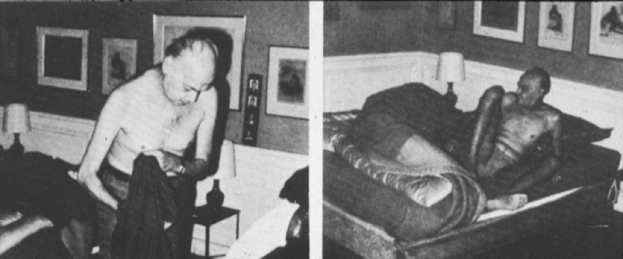
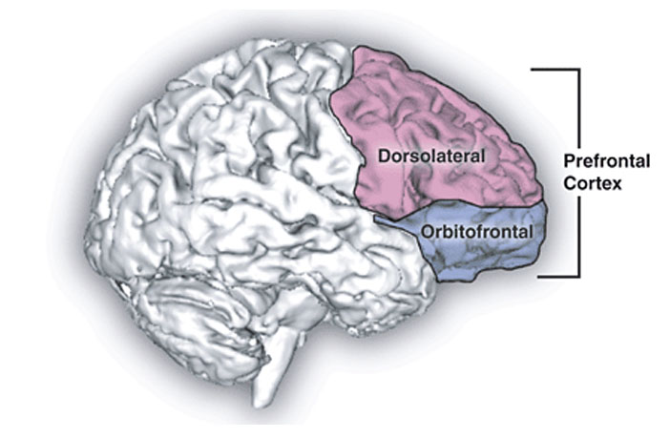
Executive Functions
Ways to test executive function
Sequencing and planning: Tower of London task
Problem-solving/inhibition/task-switching: Wisconsin Card Sort Test (WCST)
For young children: A-not-B task (inhibition), dimensional card sort task
Inhibition: Stroop task
Error Monitoring: Flanker or Stroop task
Error-related negativity (ERN): negative-going ERP that increases when errors are made
Originates in anterior cingulate cortex (ACC)
Environmental dependency syndrome
Inability to inhibit prepotent response for objects/environments
E.g. getting undressed and lying in bed despite it not being your bed/house
Frontal lobe plays a crucial role here
Orbitofrontal cortex (OFC) involved in social behavior and inhibition of socially inappropriate activities
Mnemonic: “Of course (OFC) I would never do that in public!”

Slide 4
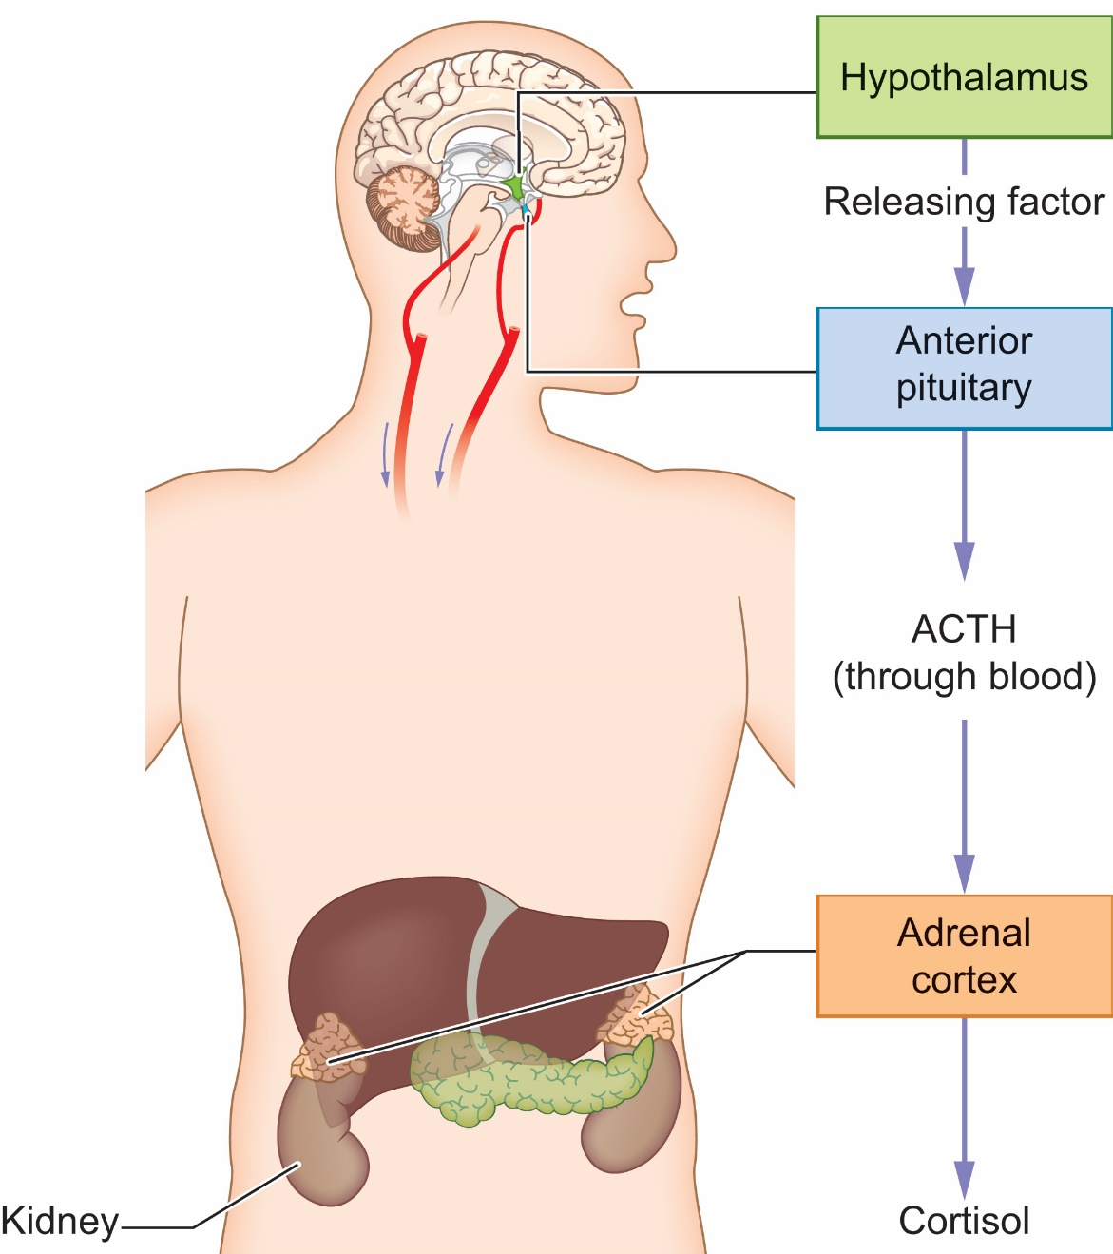
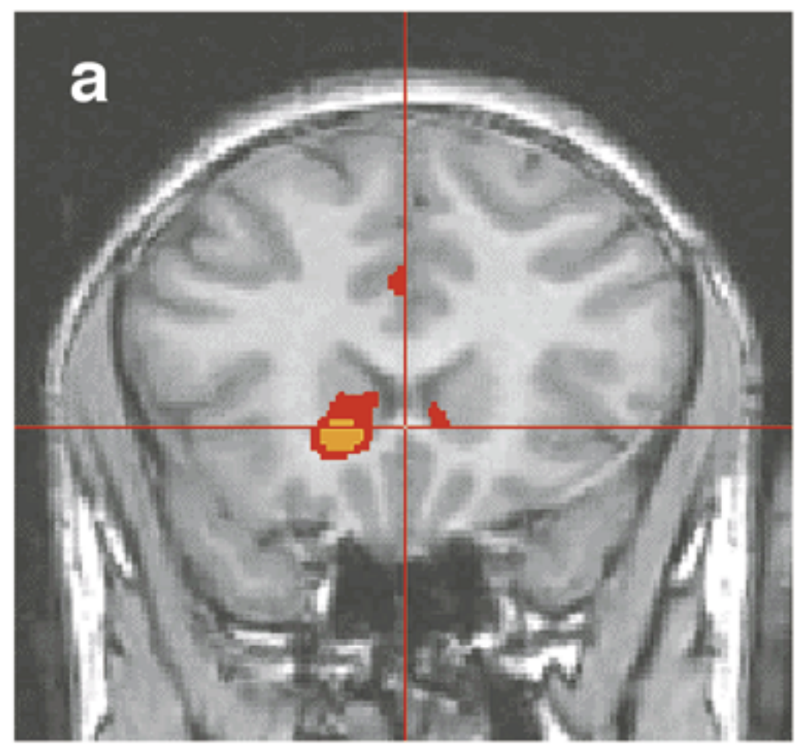
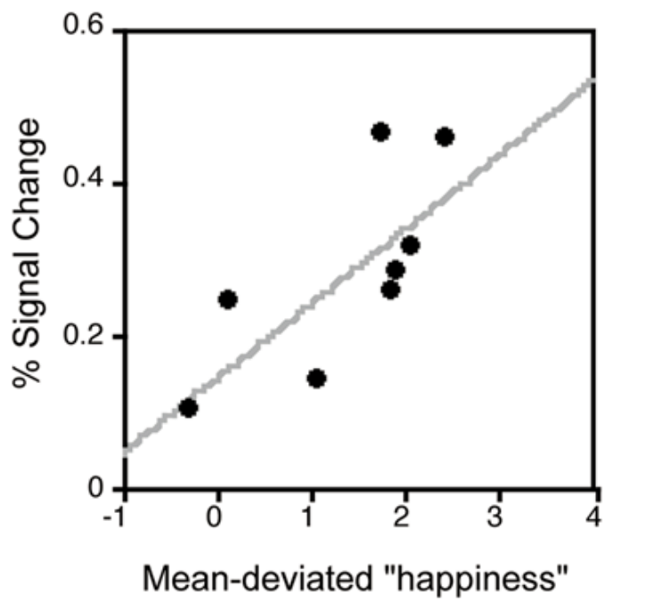
Emotion
Subcortical regions implement more automatic/subconscious aspects of emotion
Autonomic nervous system
Sympathetic (fight or flight)
Parasympathetic (rest and digest)
Hypothalamus, HPA axis
Limbic system
AMYGDALA
Responsible for fear conditioning
HPA (hypothalamus-pituitary-adrenal) axis
Hypothalamus stimulates pituitary gland
Pituitary gland secretes ACTH into blood
ACTH travels to adrenal cortex
Adrenal cortex releases cortisol
Effects of cortisol
Changes in body (heartrate, sweating)
Improvements in memory (especially for high arousal items)
Rewards/pleasure
Nucleus accumbens

Slide 5
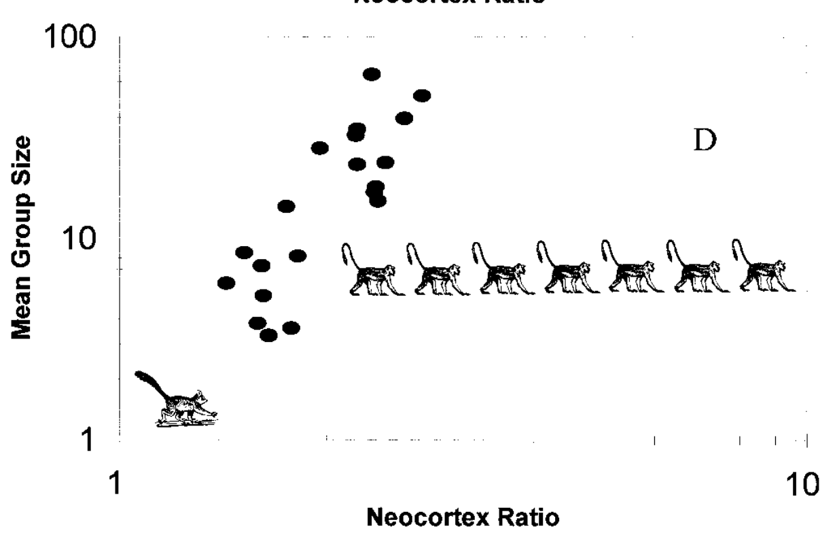
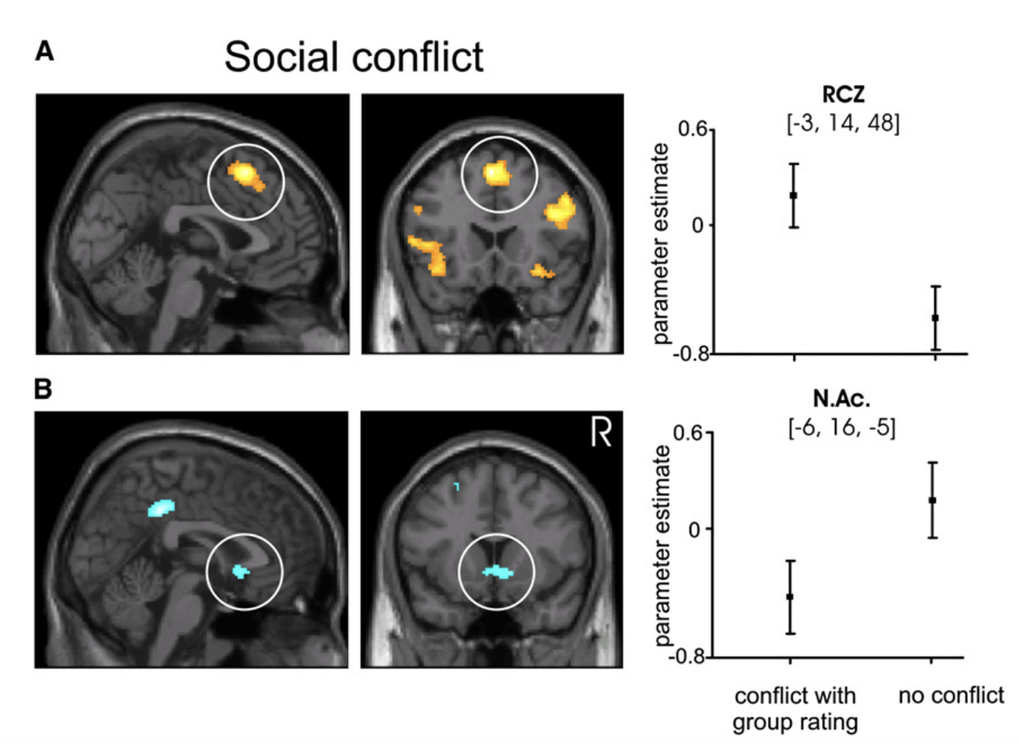
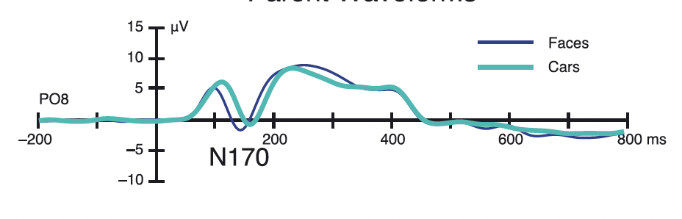
Social Cognition
Social brain hypothesis
Primate brains evolved to support social behavior
Larger group size = larger brain, bigger neocortex:medulla ratio
Asch experiment
People are susceptible to the influence of other witnesses
More witnesses = bigger effect
Effect diminishes when unanimity is broken
Attractiveness ratings
When group differed: activation in rostral cingulate zone (RCZ)
When group agreed: activation in nucleus accumbens (NAc)
Mentalizing tasks
Social animation task
“Why did the triangle hide inside the house?”
False belief task
Requires theory of mind (understanding one person’s information/feelings might be different than yours)
One area involved in both tasks: temporoparietal junction
N170
Negative-going ERP
Larger amplitude for faces than other objects
Earlier peak for faces than other objects
In-groups and out-groups
People form them rapidly and arbitrarily
E.g. “under-estimators vs. over-estimators”
Affects processing very early in the pathway

Slide 6
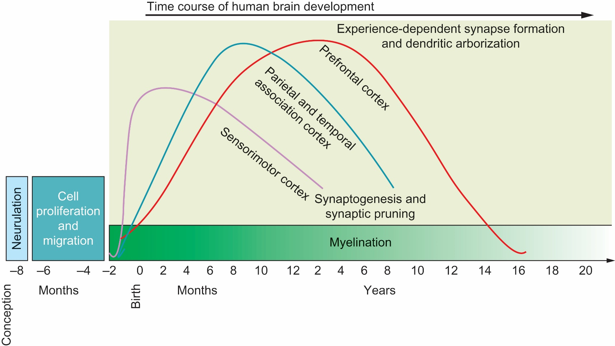
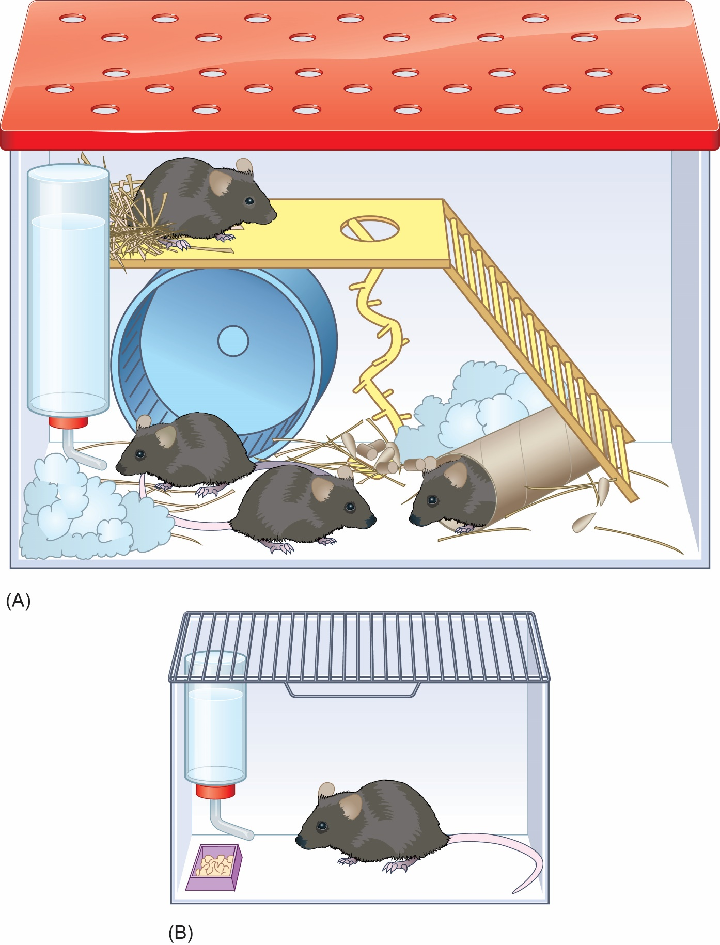

Neurodevelopment and Plasticity
Early development
Neurulation: formation of hollow tube that becomes brain and spinal cord
Neurogenesis: creation of neurons (occurs in womb)
Neurons migrate along glial cells from the inside of the ventricle to their final destination
Synaptogenesis: massive proliferation of synaptic connections across the brain, occurs after birth – followed by pruning
Not all regions bloom/prune at the same rate
Visual areas bloom/prune early (before age 5)
Frontal areas continue pruning well into teen years
Myelination: white matter tracts develop thicker fatty layer that helps facilitate rapid transmission of signals
Experience-expectant systems
Visual areas – need light in order to develop and function at all
Experience-dependent systems
Motor coordination areas – develop according to experience
Enrichment
Enriching environment leads to more dendritic spines = more connectivity
Plasticity following brain damage
Necrosis = when cells die at the site of damage
Transneuronal degeneration: cell loss extends to distal neurons
Recovery: neurogenesis, gliogenesis, and angiogenesis

Slide 7
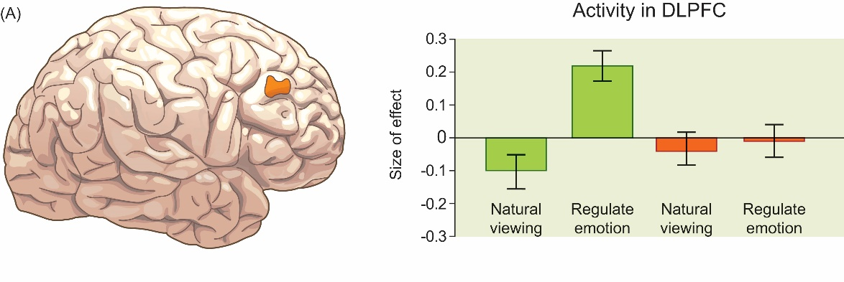
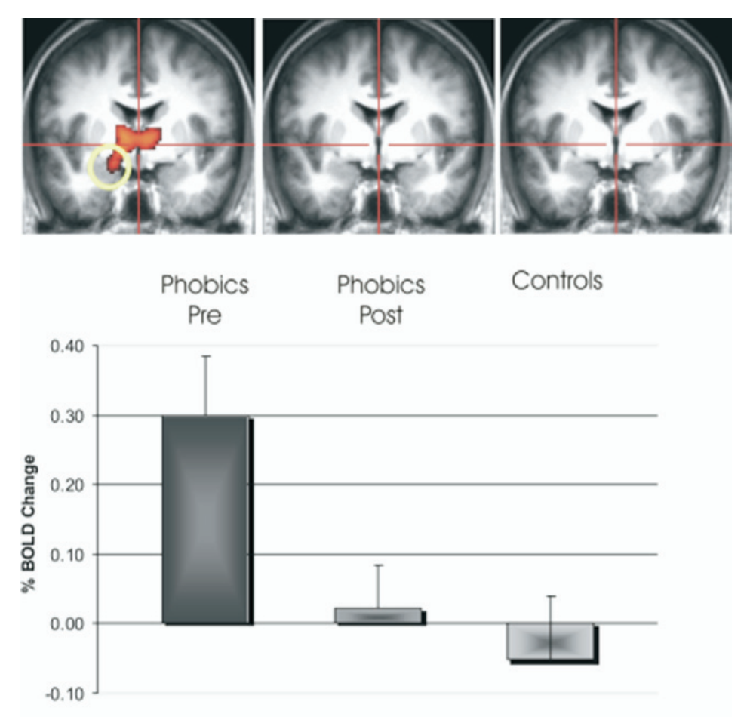
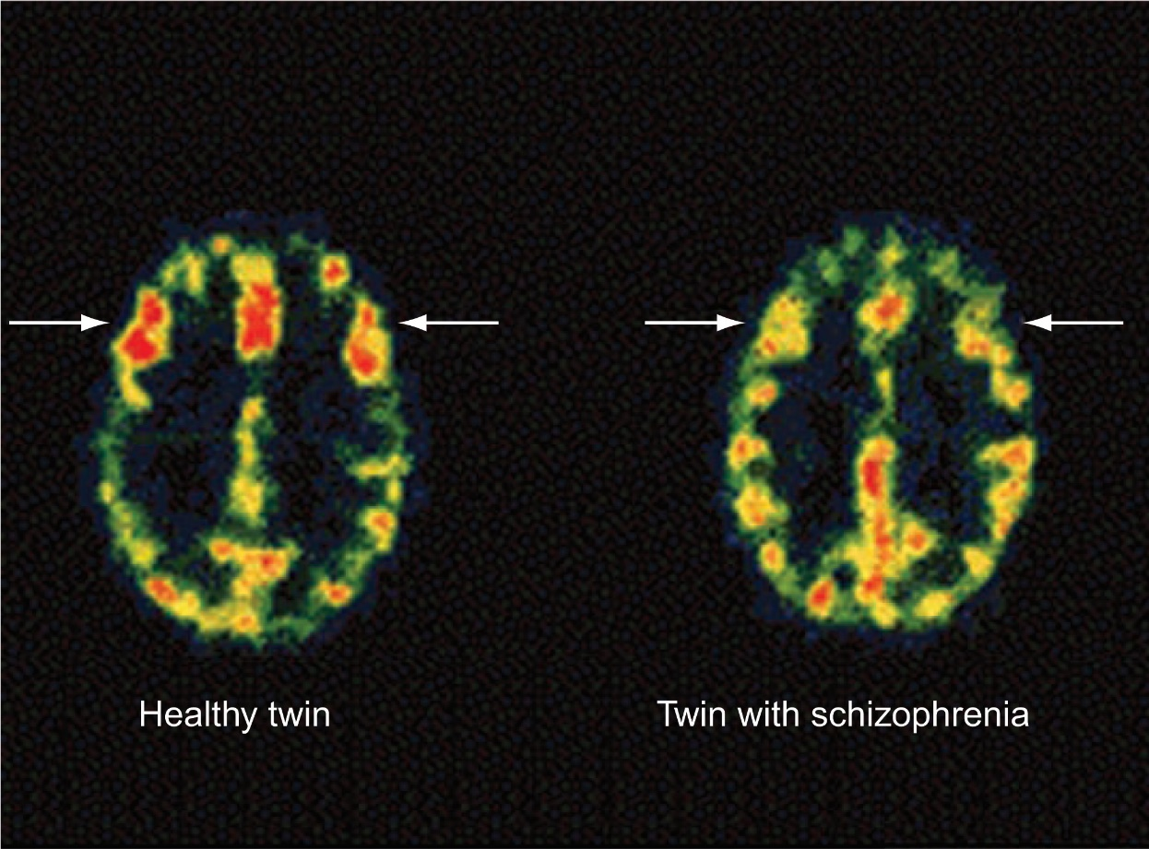
Clinical Cognitive Neuroscience
DSM 5
Manual for establishing mental disorder criteria
Depression
Disrupted DLPFC and ACC activity
Makes it difficult to shift mental states
Difficulties with emotional regulation and error processing
Disrupted connection between DLPFC and amygdala
Most common treatment: therapy + medication
Less common: ECT, DBS, tDCS, TMS, vagus nerve stimulation
Anxiety
Phobias, panic disorders, GAD, PTSD, OCD
For phobias: overactive amygdala response to fear-inducing stimuli
Exposure therapy works to help amygdala regulate itself
Schizophrenia
Positive symptoms: hallucinations, delusions, disorganized speech/behavior
Negative symptoms: anhedonia, lack of interest in world, social withdrawal
Disrupted processes: working memory, self-monitoring, attention, cognitive control, behavioral flexibility
Anterior cingulate cortex activity reduced
Hypofrontality: reduced activity in frontal lobes when at rest and when engaged in frontal-lobe-supported tasks
Substance use disorders
More activity/spines in nucleus accumbens, less in orbitofrontal cortex (OFC)
Depression reducing emotional regulation in DLPFC
Exposure therapy reducing overactive amygdala
Hypofrontality in schizophrenia

Slide 8
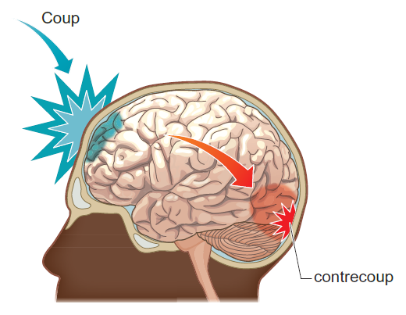
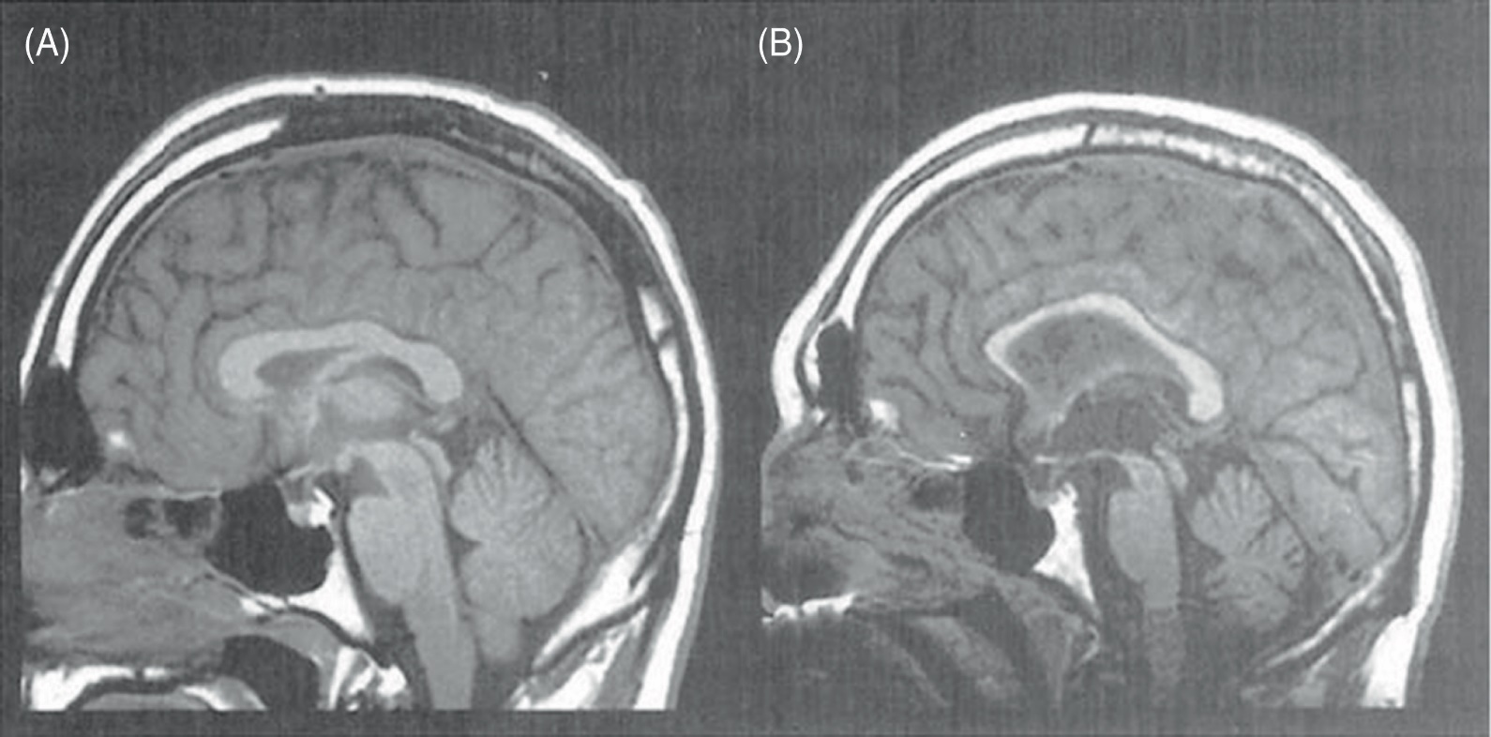
Generalized Cognitive Disorders
Closed head injuries
Coup vs. countercoup
Site of impact is damaged, also site opposite of impact is damaged
White matter tract shearing
White matter tracts have very long axons that are easily torn
Damage/deterioration can last years
Enlarged ventricles
Glutamate excitotoxicity
Damage causes some neurons to release too much glutamate, which kills surrounding neurons
Glasgow Coma Scale
Measures eye movement, motor response, and verbal response
Predictive of mortality/recovery post-insult
Long term risks/consequences
Attention/executive function usually impaired
Increased risk for: further head injuries, dementia, epilepsy

Slide 9
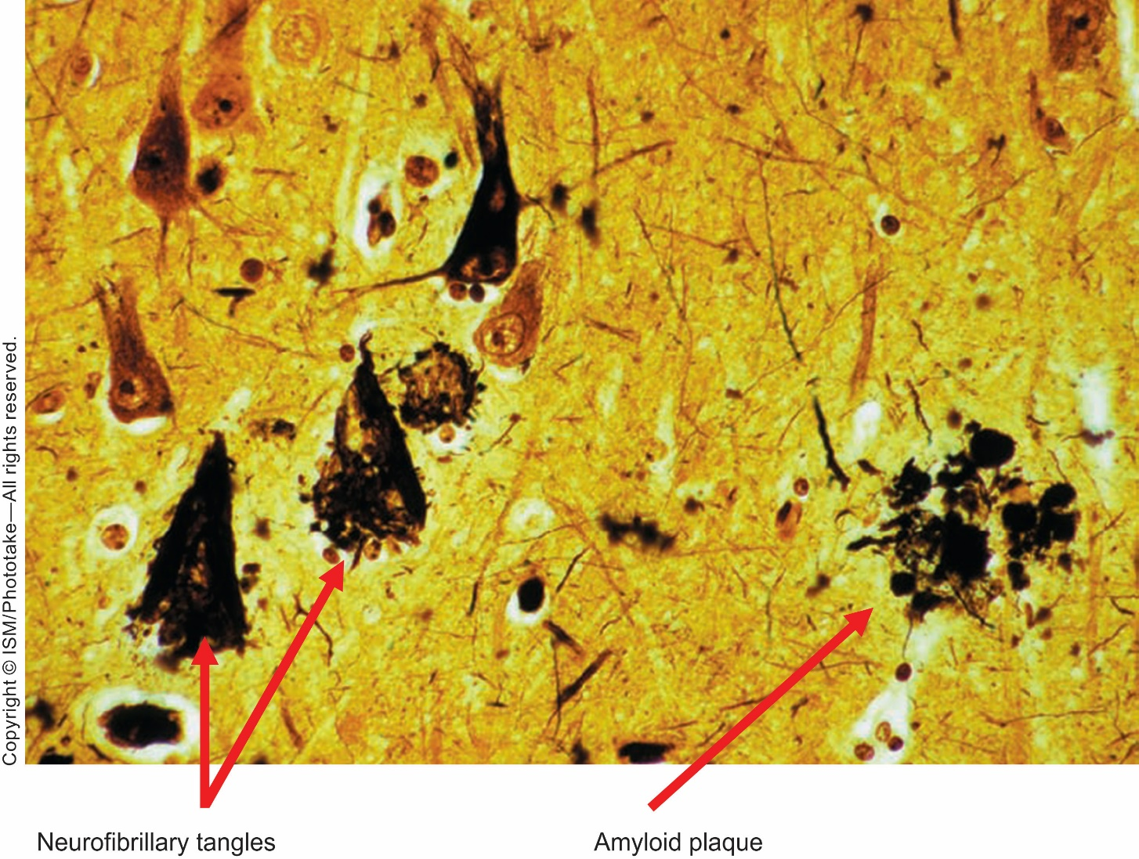
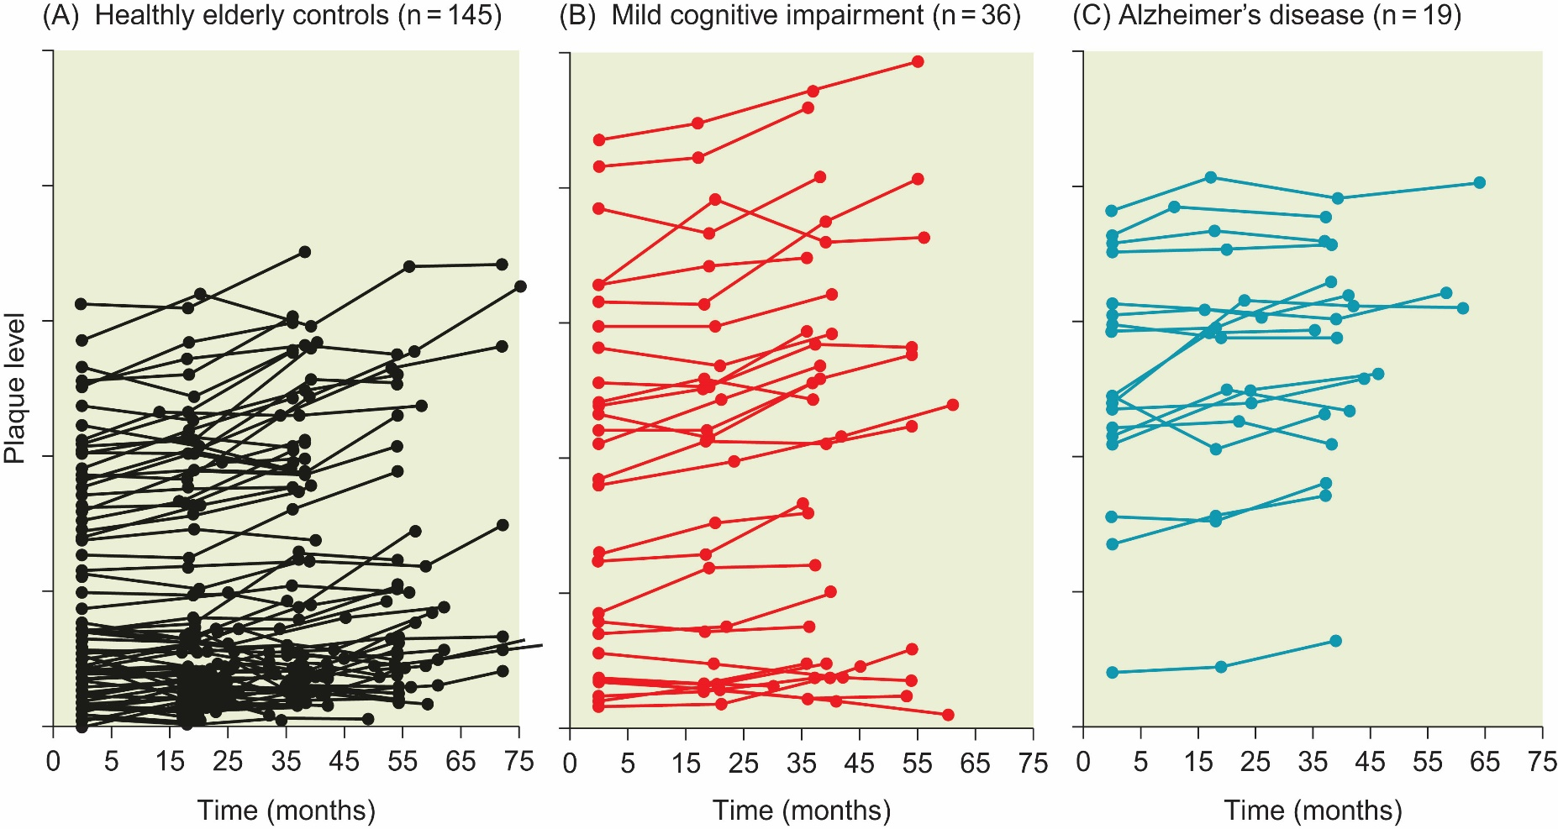
Generalized Cognitive Disorders
Alzheimer’s Disease
Form of cortical dementia
Early stage symptoms: issues with memory (including procedural and explicit memories), problem-solving, planning
Late stage symptoms: complete inability to form new memories, severe personality changes, loss of awareness, loss of movement/motor control
Characterized by amyloid plaques and neurofibrillary tangles
Tangles impact acetylcholine channels – very important for attention/executive function
Overall loss of brain tissue/volume
Neurofibrillary tangles Amyloid plaques

Slide 10
Summary of Important Brain Regions and their Primary Functions (for the purposes of this class)
Frontal cortical areas:
Most susceptible to effects of aging
Prefrontal cortex (source of attentional control)
Working memory, modulation of attention in other areas
Orbitofrontal cortex
Primary function: modulating social behavior
Anterior cingulate cortex
Primary function: error monitoring
Rostral cingulate zone (lights up when you disagree with social group)
Secondary: problem-solving/decision-making, emotional regulation
Subcortical areas:
Nucleus accumbens
Primary function: motivation/reward processing, goal-directed behavior
Heavily implicated in substance abuse cases – addictive drugs boost dopamine levels in Nac
Thalamus (includes LGN)
Primary functions
Attention: uses glutamate to modulate level of arousal in cortex
Sensory integration
Hypothalamus and HPA axis
Triggers physiological stress response
Insula
Involved in a bunch of different processes
Taste/smell integration, perception of disgust, interoception, substance abuse, motor control…
That’s why I left it out of the final – too confusing!

